Slide 1
Ludwig Van Beethoven
Katie Wallin

Slide 2
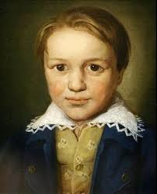
Beethoven’s Early Years
Beethoven’s Baptism
Early years
Family of five
First musical experiences
Notes:
Beethoven’s birthdate is said to be unknown so his story begins on the day he was baptized; December 17, 1770 in Bonn, Germany. He was born to his father Johann Beethoven and his mother Maria. His father was a Tenor singer and influenced Beethoven’s start to his music career. Beethoven had two younger brothers Caspar and Johann junior. Growing up Beethoven was taught about music by his father and hated the idea at first because of how brutal his father taught it. Beethoven eventually found inspiration in his grandfather, Kapellmeister Ludwig Van Beethoven, a well known inspirational musician in Bonn.

Slide 3
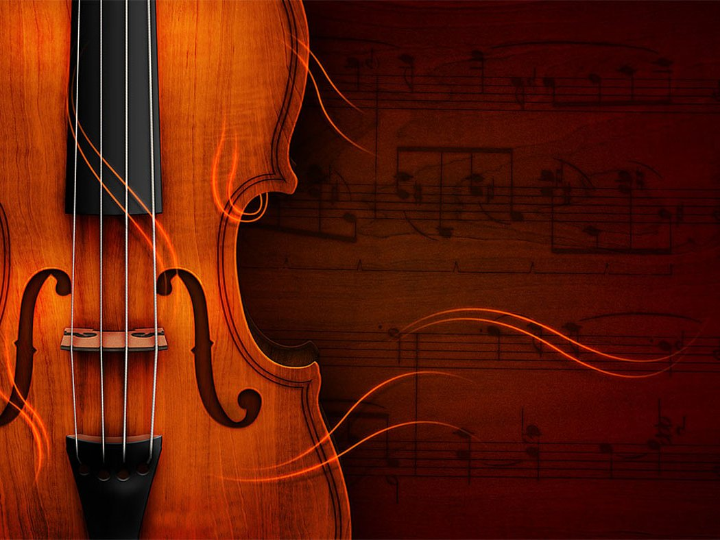
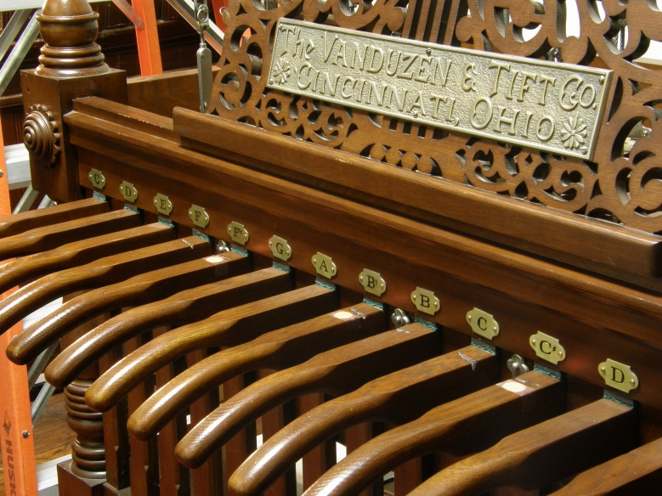
Early Talented Musician
Music 24/7
Instrument practice
Musical prodigy
First performance
Learning disability
Notes:
Even from the beginning Beethoven started out as a talented musician. He was constantly under the pressure of his father to be better and practice day and night without sleep. Beethoven starting out practicing the violin, clavier and organ. His father wanted him to be a musical prodigy like Mozart. He had his first performance on March 26, 1778 when he was seven years old. He succeeded in earning many applause but he received no recognition from the press like his father had hoped so he decided to start Beethoven in school. Beethoven attended a Latin school called Tirocinium but wasn’t there for long as he was found to be dyslexic and quit school to focus on music.

Slide 4
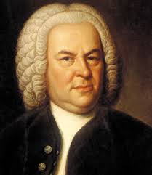
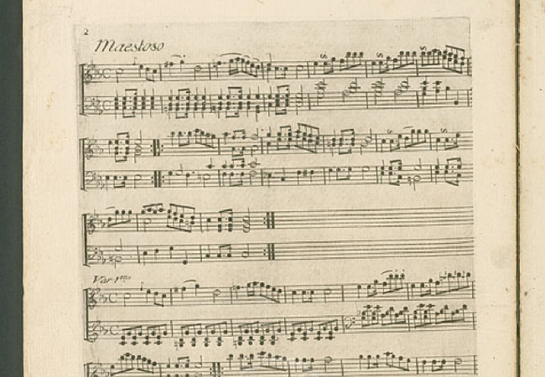
Music Study
Studied in music
Famous musician Bach
First composition
Taking responsibility
Notes:
After dropping out of school Beethoven began to study music with Christian Neefe a local court organist. In working with Neefe Beethoven was introduced to Bach, a famous musician of the time, and was able to compose his first piece of music. The piece consisted of piano variations and was inspired by Dressler a classical composer. After his piece was composed he was forced to be the family provider as his father was overtaken by alcoholism. He requested to be an assistant court organist with Neefe and was accepted.

Slide 5
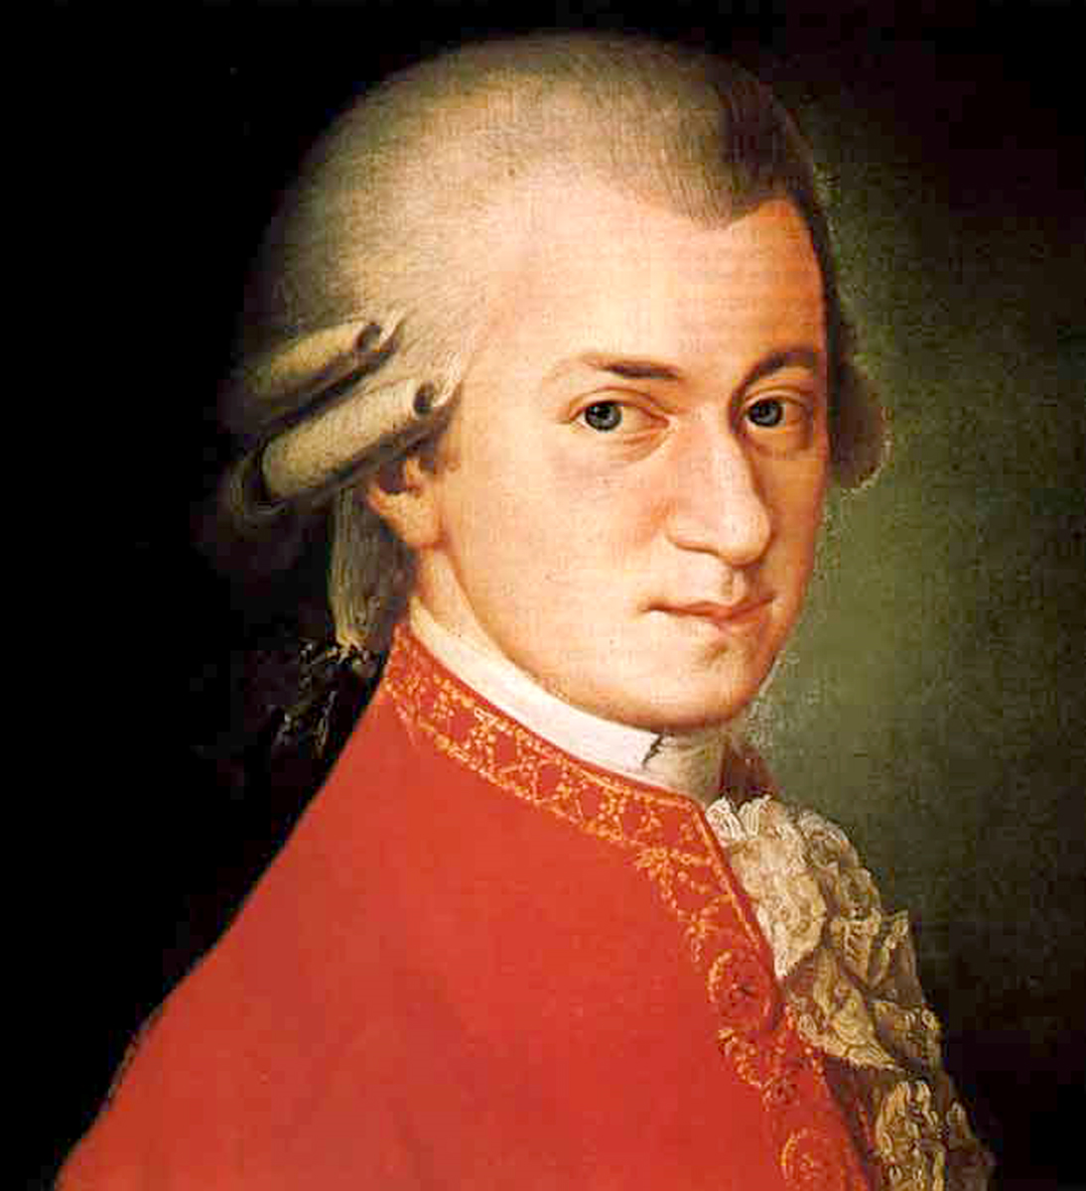
On To Vienna…
Studying with Mozart
Getting noticed
Family first
Notes:
In 1787 the court decided to send Beethoven to Vienna to study music with Mozart. When he arrived he auditioned in front of Mozart and received great recognition from him. Mozart stated, “Keep your eyes on him; some day he will give the world something to talk about.” Beethoven wasn’t in Vienna for long as his mother fell ill. He traveled back to Bonn and is mother died shortly after his return. Beethoven fell into a deep depression after his mother’s passing and decided to focus on his career in his home town with his family.

Slide 6
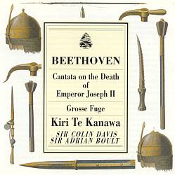
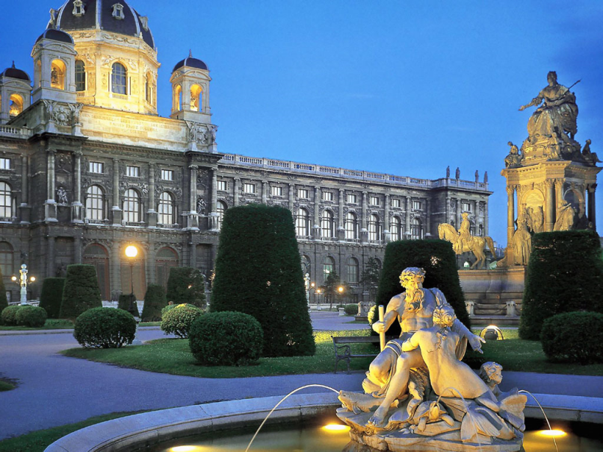
Another inspiration…
Cantata on the Death of Emperor Joseph II
Creating a masterpiece
Back to Vienna
More famous composers
Notes:
In 1790 Holy Roman Emperor Joseph II died giving Beethoven a chance to compose a memorial piece in his honor. The piece was never performed but it was discovered by Johannes Brahms a century later. The piece was titled Cantata on the Death of Emperor Joseph II. It was considered to be one of Beethoven’s earliest masterpeices. Two years later he traveled back to Vienna to further his career. There he studied music with Joseph Haydn, Antonio Salieri and counterpoint with Johann Albrechtsberger.

Slide 7
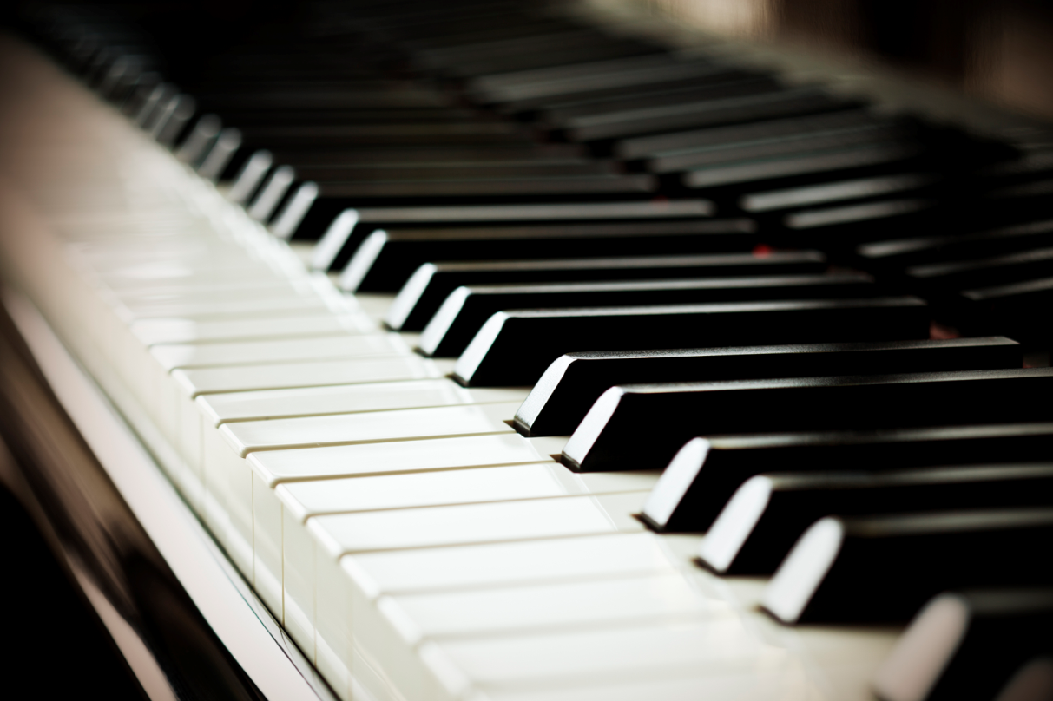
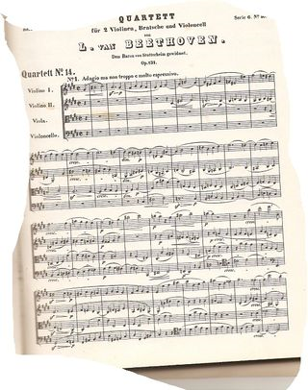
A Piano Expert
Piano provides luxuries
Another debut
More composing
Notes:
Beethoven was mainly recognized for his piano work. Beethoven was provided housing and funds by the patrons on Vienna which allowed him in 1794 to sever ties with the Electorate of Cologne. After all his hard work Beethoven debuted in Vienna on March 29, 1795. It was said that he performed a piano concerti in C major. After his performance he published a series of three piano trios called “Opus 1” which was known to contribute greatly to his financial success. On April 2, 1800 Beethoven debuted his first symphony which was titled Symphony No. 1. He performed it in C major at the Royal Imperial Theater in Vienna. After this performance he became known as one of Europe’s most celebrated composers. After this Beethoven composed piece after piece that made him a master composer and a newly matured musician. In 1801 he composed his “Six String Quartets” and “The Creature of Prometheus”.

Slide 8
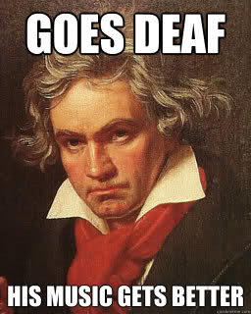
Overcoming a Failure
Eroica Symphony
Going deaf
Complete success
Beethoven’s “Heroic” period
Notes:
In 1804 Napoleon Bonaparte proclaimed himself emperor and Beethoven debuted his Symphony No. 3 in Napoleon’s honor. This symphony was later named “Eroica Symphony”. As Beethoven was overcome with so much success, he was also battling a personal failure. He was going deaf. Despite his handicap, Beethoven continued to compose. From 1803-1812 he composed an opera, six symphonies, four solo concerti, five string quartets, six string sonatas, seven piano sonatas, five sets of piano variations, four overtures, four trios, two sextets and 72 songs. His most famous of the symphonies was “Moonlight Sonata” and “Kreutzer”. This period was known as Beethoven’s “heroic” period.

Slide 9
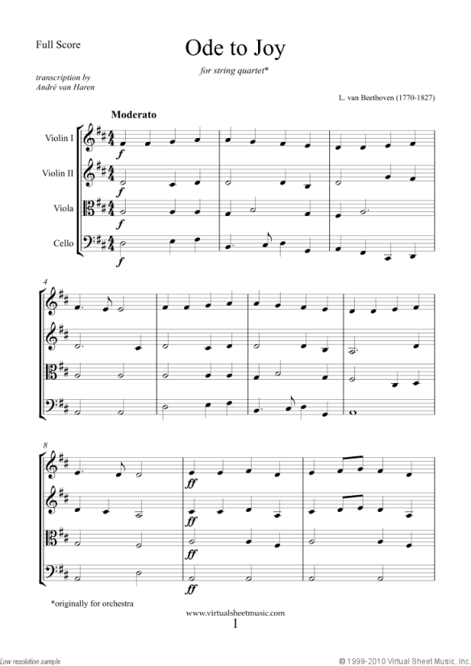
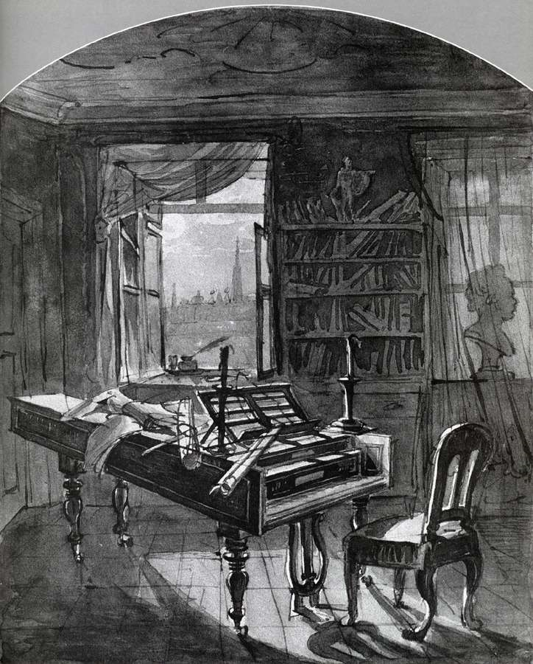
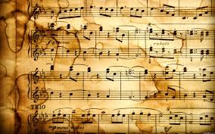
His Last Years…
Most famous pieces
Missa Solemnis
String Quartet No. 14
Symphony No. 9
Ode to Joy
Beethoven’s Death
Notes:
Beethoven was nothing but miserable if he wasn’t playing or writing music. Beethoven was said to have composed his greatest pieces the last ten years of his life. Some of which included “Missa Solemnis”, String Quartet No. 14, Symphony No. 9, and his world famous song “Ode to Joy”. Ludwig van Beethoven died on March 26, 1827 at the age of 56. Beethoven will always be remembered as the greatest composer of his time. He was connected to the Classical, Romantic and Western ages and his music was also featured in Shakespeare’s plays. He is most famous for being able to compose such amazing pieces while dealing with deafness most of his career. Some of Beethoven’s last words were some he borrowed from a friend stating, “Plaudite, amici, comoedia finite est,” which means “Applaud friends, the comedy is over.”

Slide 10
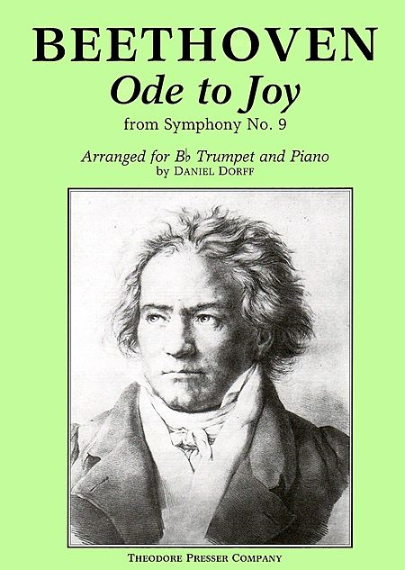
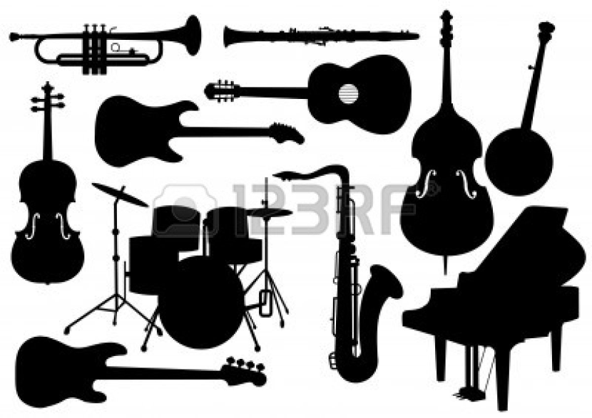
Music History Ode to Joy Fourth Movement
Wide Variety of instruments
Chorus and soloists
A tone made up of happiness
Based on the poem by Friedrich Schiller
A part of Beethoven’s Symphony No. 9
Notes:
Beethoven’s symphony no. 9 represents what they call the apotheosis of Beethoven’s symphonies. It started back in 1809 when Beethoven started writing notes that were later used in this symphony. The overall material he used for the symphony was made up between 1822 and 1824. He made it up of a wide variety of instruments along with chorus and soloists. Its tone is made up of happiness that is captured in every instance of the song. In the beginning the song was given the name “The Symphony of Joy.” At the time Beethoven was very interested in a poem written by Friedrich Schiller called “The Ode to Joy” that was written in 1793. As he liked the poem so much he decided to write a song named after the poem. Beethoven’s song “Ode to Joy” was added to symphony no. 9 during part IV a year before the symphony was completed.

Slide 11
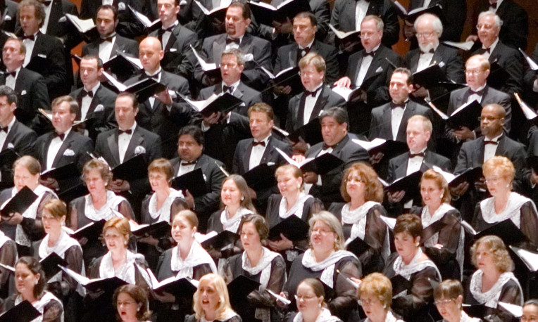
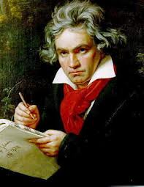
Ode to Joy cont…
Final written symphony
Written in D minor
Voices make it a choral symphony
4 vocalists and a chorus
Completed in February 1824
Performed May 7, 1824
3 examples based on symphonic ideas
Notes:
Symphony no. 9 was Beethoven’s final written symphony. It was written in D minor and voices that formed a chorus making it a choral symphony. The singing was made up of four vocalists and a chorus. It was worked on from 1822 to 1824 when it was finally completed in February. Although most of his work had been shown in Vienna, Beethoven wanted to perform this symphony in Berlin. The symphony was performed May 7, 1824 in the Theater am Karntnertor in Vienna. Beethoven’s symphony no. 9 is often described as a piece of work that broke free from the “Classical Era”. In the Ninth Beethoven wrote three of the most complete examples of his symphonic ideas. In the first movement he included architectural and sonic scheme, the second had Classical scherzo and the end had a set of variations in the Adagio molto e cantabile.

Slide 12
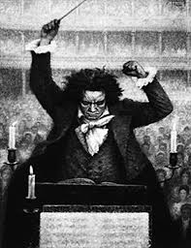
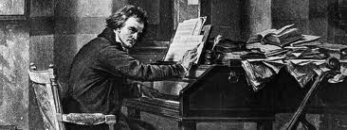
Ode to Joy cont…
Beethoven’s greatest accomplishment
Well recognized
Fame and Fortune
Ideas passed on the famous musicians
Carried on his legendary work
Notes:
Beethoven’s ninth symphony was said to be one of his greatest accomplishments. From the first performance it received such praise and enthusiasm that it carried on to many audiences within the next decades. The early 19th century patrons of the concert halls were all very attracted to Beethoven’s style and music composition. His music was talked about from city to city and even far beyond that. Critics described this piece as “monstrous”, “tasteless”, and “falling into burlesque”. All of Beethoven’s ideas about music carried on to many other famous musicians including Bellini, Brahms, Bruckner, Mahler, and Richard Strauss. His final symphony definitely made a greater name for him to be remembered.

Slide 13
Ode to Joy Listening Guide
Form of this piece:
Introduction/Chorus/Verse 1/Verse 2/Verse 3/ Chorus/Ending
Instruments included: Piano, oboe, flute, clarinet, trombone, trumpet, piccolo, violin, bass, chimes, cymbals
Variety of fast and slow tempos, happy and upbeat harmony (consonance), dark and low harmony (dissonance), high and low pitches, conjunct and disjunct melodies

Slide 14
Lyrics
Joy is drunk by every creature
From Nature's fair and charming breast;
Every being, good or evil,
Follows in her rosy steps.
Kisses she gave to us, and vines,
And one good friend, tried in death;
The serpent she endowed with base desire
And the cherub stands before God.
O friends! Not these sounds!
But let us strike up more pleasant sounds and more joyful!
Joy, o wondrous spark divine,
Daughter of Elysium,
Drunk with fire now we enter,
Heavenly one, your holy shrine.
Your magic powers join again
What fashion strictly did divide;
Brotherhood unites all men
Where your gentle wing's spread wide.
Gladly as His suns do fly
Through the heavens' splendid plan,
Run now, brothers, your own course,
Joyful like a conquering hero
Embrace each other now, you millions!
The kiss is for the whole wide world!
Brothers - over the starry firmament
A beloved Father must surely dwell.
The man who's been so fortunate
To become the friend of a friend,
The man who has won a fair woman -
To the rejoicing let him add his voice.
The man who calls but a single soul
Somewhere in the world his own!
And he who never managed this -
Let him steal forth from our throng!
Do you come crashing down, you millions?
Do you sense the Creators presence, world?
Seek Him above the starry firmament,
For above the stars he surely dwells.

Slide 15
Listening Guide
0:00-0:45 Introduction
The song starts out very quiet with a group of string instruments and some brass (Trombone). They are deep sounding and the tempo is very slow at first. The melody of the music is dark and mysterious almost. The harmony is dissonance. The form seems to be very constant. The instruments play together first slow in tempo then gradually increase tempo and become louder then decrease back down.
0:45-1:30
The tempo begins to increase at this point in the music. More instruments are added in. It’s more of an upbeat happy melody. Violins join with a high pitch melody. You can hear flutes in the background. There are still the low bellowing of the string and brass instruments playing just how they did at the beginning. They play the same form. The same music notes are played, a wider variety of instruments. The tempo stays slow at first then picks up. The melodies are long and seem to be conjunct.

Slide 16
Listening Guide cont..
1:30-2:14
During this time the music is still playing the same melody and form. It’s just made up of different instruments. The violin, viola and small woodwinds instruments pick up. The flute and violins play a smooth texture. The melody is still conjunct. The melody is also still upbeat and happy. There are no low pitched instruments like the trombone or tuba anymore. The tempo is a little faster but not drastic, it stays constant and smooth.
2:14-3:40
Now some trumpets start to chime in. The sound of the trumpets overtakes everything else. They play an upbeat fast tempo. The melody is still happy. It’s still the same form and set of music so it’s beginning to feel familiar. The harmony of the music at this point is consonance. It’s very relaxing to listen to. There are still violins playing. Towards to end of this section the music gets slow and then picks right back up and becomes loud and fast again to end the first section.

Slide 17
Listening Guide cont..
3:40-5:00
This starts off a new verse of the song. It starts with a flute playing a smooth melody. It’s still a happy joyful melody. It has started a new form and music notes. In the section a vocalist comes in and sings solo opera. He repeats the same set of words. You can hear cymbals and maybe a triangle in the background.
5:00-6:45
The chorus begins to sing along with the vocalist. The tempo begins to get faster. Violins, cymbals, and trumpets still play. The vocalist and chorus only sing for a while until they stop and just the orchestra play. The tempo speeds up more. It’s still a happy melody. The form is the same just sped up. Towards the end of this section the tempo slows and becomes quiet to flow into the next section.
6:45-7:45
Violins start out very slow and the melody is dark. The trombone and cello play low bellowing sounds. Then suddenly the music becomes loud and boisterous. The vocalist and chorus begin to sing Ode to Joy. The temp is fast. Melody is happy and upbeat. The harmony is consonance. Trumpets play loudly. As the singers stop singing, the tempo slows and the music starts to fade into the next section.

Slide 18
Listening Guide cont..
7:45-9:30
A chorus of men begins to sing with the deep sounds of trumpets. The melody is soft and slow. The tempo doesn’t have much speed. Then some violins begin to play and a chorus of ladies sings. As the tempo picks up both the men and ladies sing together. The melody stays peaceful and soft. The harmony is still consonance. The form has changed.
9:30-11:18
The tempo slows and the whole chorus sings together but very slowly. It’s all opera singing. Violins play at the lower volume and as it progresses the trumpets play a louder tone. The tempo and melody go up and then down in sync. The melody is kind of sad and depressing but still slow and easy to follow a rhythm. The chorus stops and a flute is played. The music is very high pitched and gets loud before it goes quiet again. The music slows to end this section of the music.

Slide 19
Listening Guide cont..
11:18-12:15
The music starts out very loud. All kinds of instruments are playing including violins, trumpets, trombone, cymbals, and flutes. The opera is singing loudly. The tempo is very fast. The harmony is happy and exciting. The form has changed during the section. Completely new set of music notes. The rhythm stays pretty constant going up and down. As the end nears, the opera stops singing and the song become soft.
12:15-13:00
The opera sings softly as implies that the music is about to end. The tempo very slow, the harmony is peaceful and sound. Then it suddenly gets loud and all the orchestra is playing, the tempo is fast, the opera sings at high pitch and volume. Everything reaches its high point of the music and it ends with the trumpets giving one last sound.

Slide 20
Works Cited
Biography True Story Ludwig van Beethoven
http://www.biography.com/people/ludwig-van-beethoven-9204862?page=5
About.com Ludwig van Beethoven
http://musiced.about.com/od/classicalmusicians/p/beethoven.htm
All About Beethoven
http://www.all-about-beethoven.com/symphony9.html
American Bach Soloists
http://www.americanbach.org/recordings/BeethovenNotes.htm
About.com Classical Music
http://classicalmusic.about.com/od/classicalmusic101/a/beethovenguide.htm
YouTube-Beethoven’s Ninth Symphony (Ode To Joy) Fourth Movement
Google Images
Beethoven’s Ninth Symphony Fourth Movement
http://edboyden.org/beet9.html

